Slide 1


Spinal Cord Segmentation Generalizable Across Datasets
Louis-François Bouchard - PhD Student at Polytechnique Montréal

Slide 2
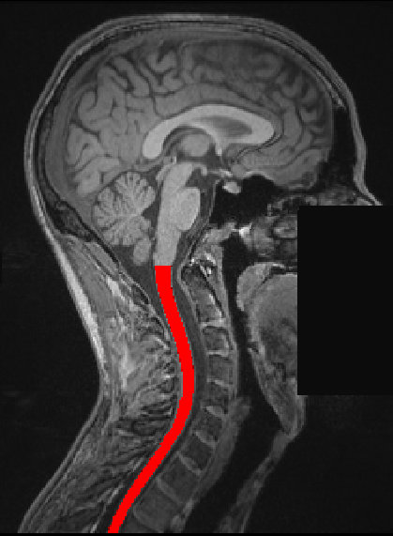
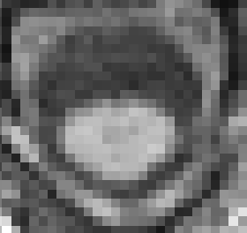
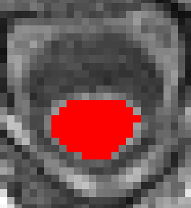
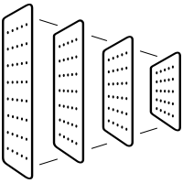


Background
Spinal cord segmentation is clinically relevant
(e.g. notably to compute cross-sectional area for the diagnosis and monitoring neurodegenerative diseases such as multiple sclerosis*, characterizing spinal cord compression**, …)
Problem, MRIs depend on…
MRI Contrast
Vendor
Pathologies
U-Net
Ground Truths (Manual Segmentation)
*Martin, A.R., De Leener, B., Cohen-Adad, J., Kalsi-Ryan, S., Cadotte, D.W., Wilson, J.R., Tetreault, L., Nouri, A., Crawley, A., Mikulis, D.J., et al.: Monitoring for myelopathic progression with multiparametric quantitative mri. PLoS One 13(4), e0195733 (2018)
**Barkhof, F., Filippi, M., Miller, D.H., Scheltens, P., Campi, A., Polman, C.H., Comi, G., Ader, H.J., Losseff, N., Valk, J.: Comparison of mri criteria at first presentation to predict conversion to clinically definite multiple sclerosis. Brain: a journal of neurology 120(11), 2059–2069 (1997)

Slide 3
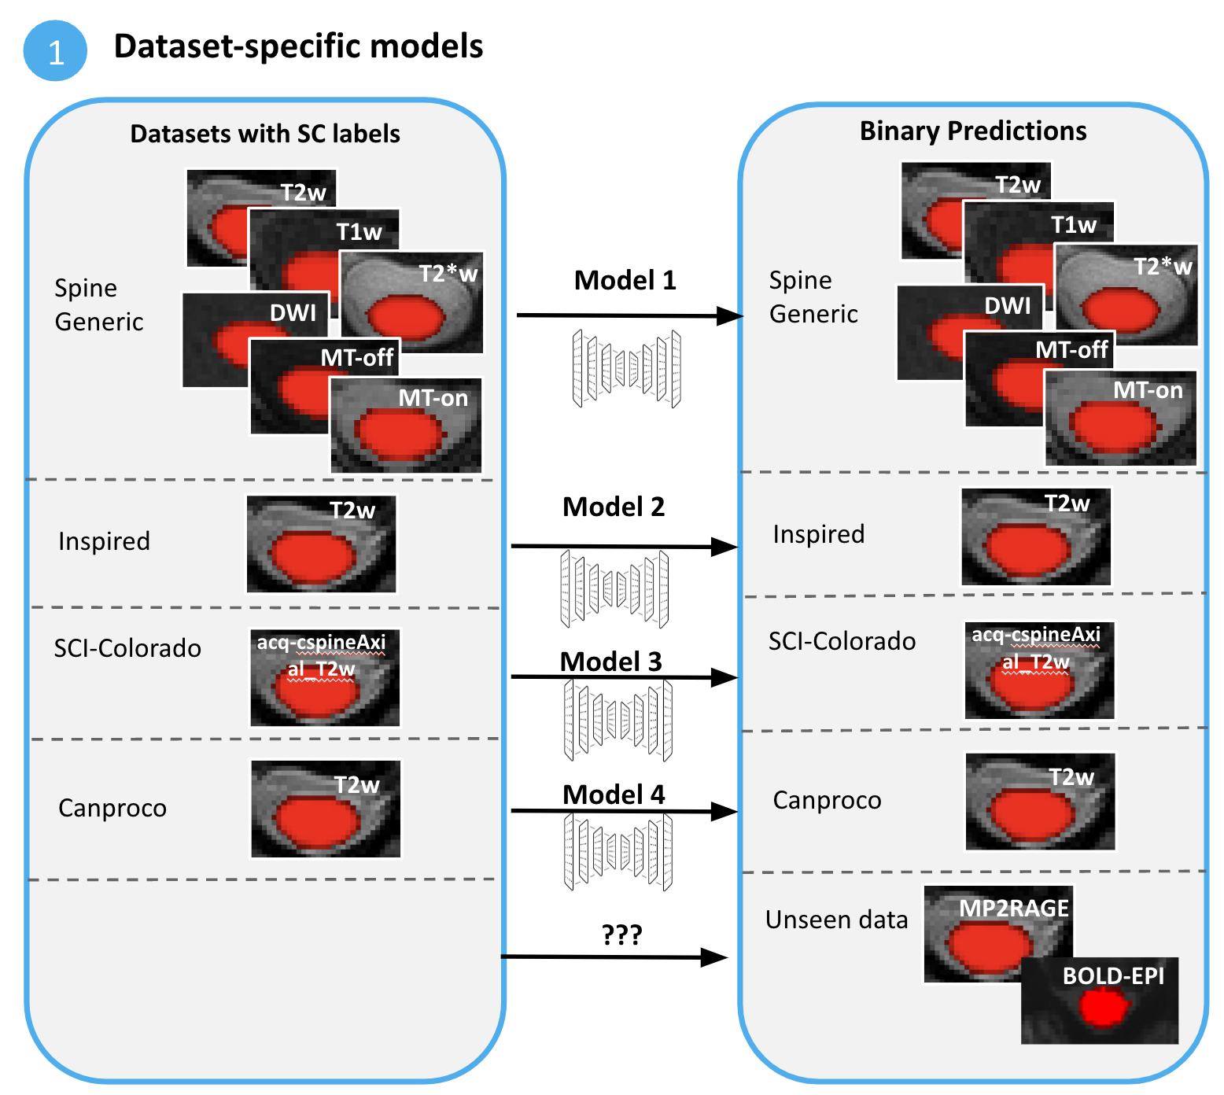
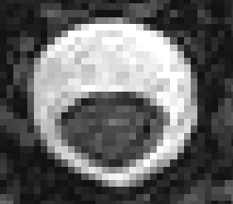

Main Question
Specific-model approach
Not ideal!
Can we build a general approach to automatically perform Spinal Cord Segmentation across contrasts, vendors and pathologies?
A
A
R
L
R
L
P
P
T1-weighted
T2-weighted

Slide 4
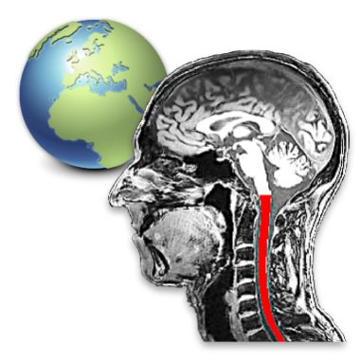
Data:
Various (6) Spinal Cord MRI datasets available at Neuropoly with manual segmentation.
Our training datasets:
Spine Generic Public Database* (multi-subject), n=244, 3 vendors, 6 contrasts (T2w, T1w, T2*w, 3D axial GRE (MTon), GRE-T1w (MToff), DWI), pathology: Mild Compression, Healthy Controls.
INSPIRED, n=79, 1 contrast (acq-cspineAxial_T2w), pathology: Degenerative Cervical Myelopathy (38), Spinal Cord Injury, Healthy Controls.
SCI-Colorado, n=80, 1 contrast (T2w), pathology: Spinal Cord Injury.
Canproco, n=445, 1 contrast (T2w), pathology: MS.
Test datasets (outside training distribution):
Basel-mp2rage, n=283, 1 contrast (MP2RAGE "UNI"), pathology: Multiple Sclerosis (180), Healthy Controls (103).
Extra: Rohan’s fMRI test set, n=8, 1 contrast (EPI-GRE).
-> Multiple contrasts, conditions, vendors… 👍
* Cohen-Adad, J., Alonso-Ortiz, E., Abramovic, M., Arneitz, C., Atcheson, N., Barlow, L., Barry, R.L., Barth,
M., Battiston, M., Büchel, C., et al.: Open-access quantitative mri data of the spinal cord and
reproducibility across participants, sites and manufacturers. Scientific data 8(1), 219 (2021)

Slide 5

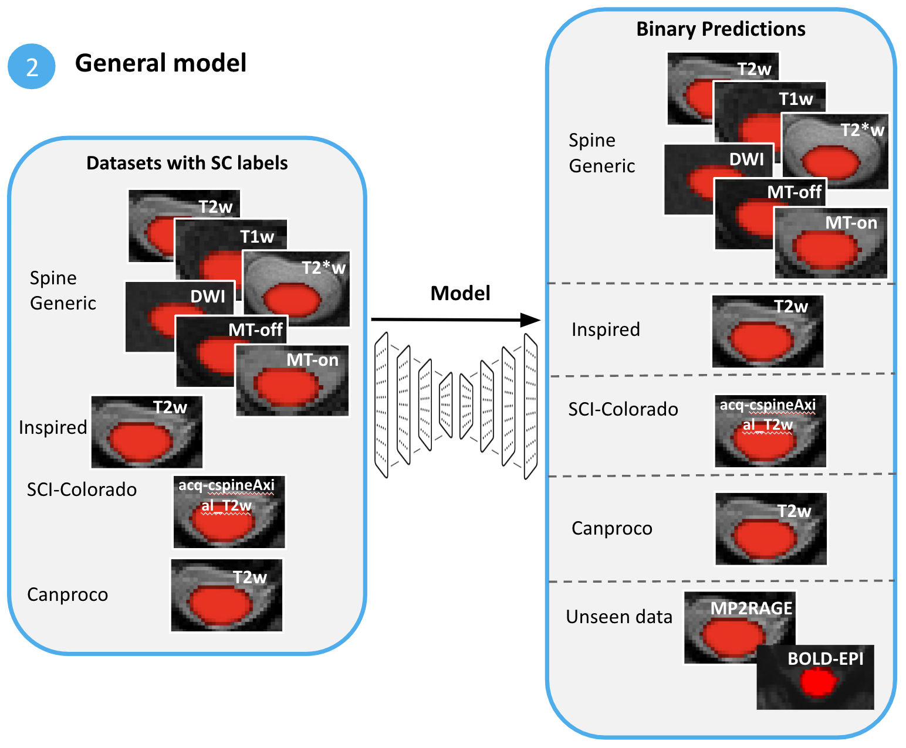
Specific-model approach
4 models!
Tools & Methods
1 model!
General-model approach
Python/Pytorch/Git/ssh/Jupyter Notebooks
nnU-Net -> a state-of-the-art “self-configuring method for deep learning-based biomedical image segmentation”.
Train and compare the 2 frameworks for performing automatic spinal cord segmentation
All experiments are using the same train/test splits.
Images are all re-oriented to RPI
nnU-Net
nnU-Net
nnU-Net
All models are based on nnU-Net

Slide 6
Objectives
Adapt a script for converting N BIDS datasets into one large “nnU-Net-ready” dataset train/test split. ✅
Compare a general model to specific models for spinal cord segmentation on the specific datasets’ test sets. (i.e. see if general model ~ specific models on their test sets) ✅
Test the resulting 2 frameworks on an external dataset to demonstrate the generalizability capabilities of the larger model. ✅ + bonus with Rohan’s fMRI dataset!

Slide 7
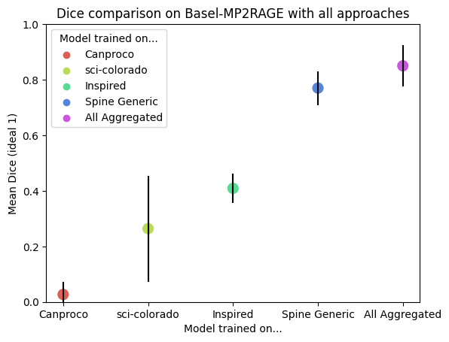
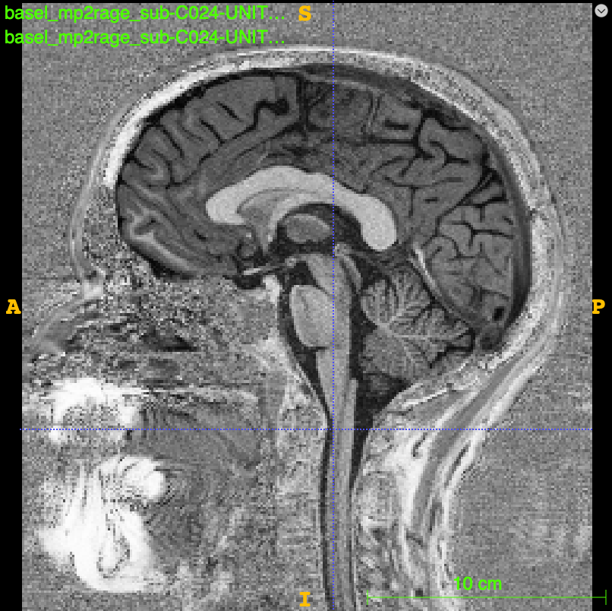
Results on Basel-MP2RAGE
MP2RAGE contrast
(over all test subjects)

Slide 8

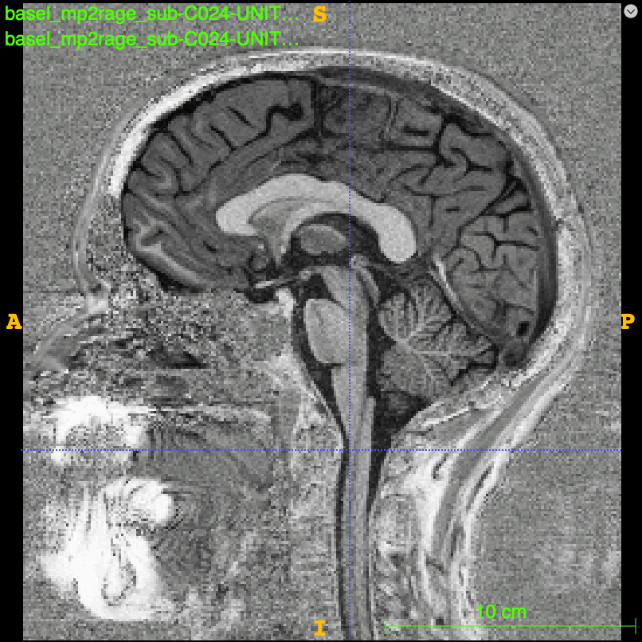

Visual results on Basel-MP2RAGE (one subject)
Manual segmentations
Aggregated-dataset model
Colorado-trained model

Slide 9
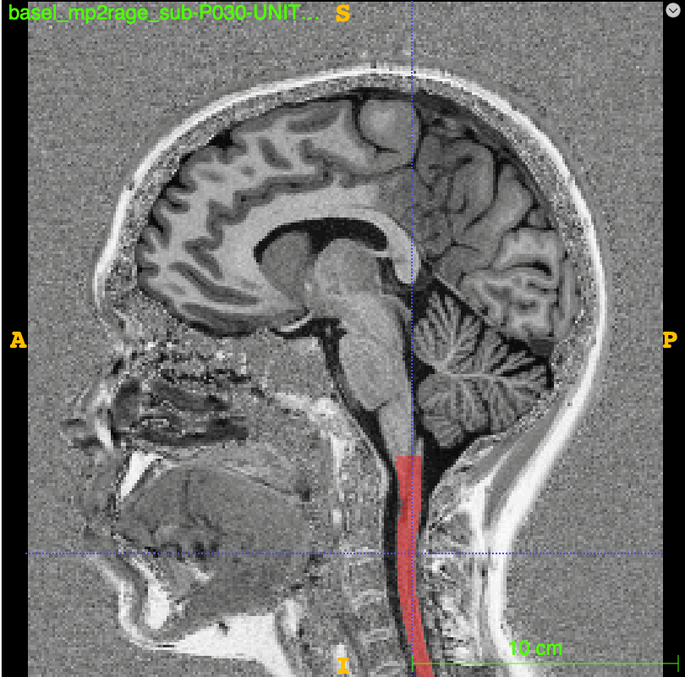
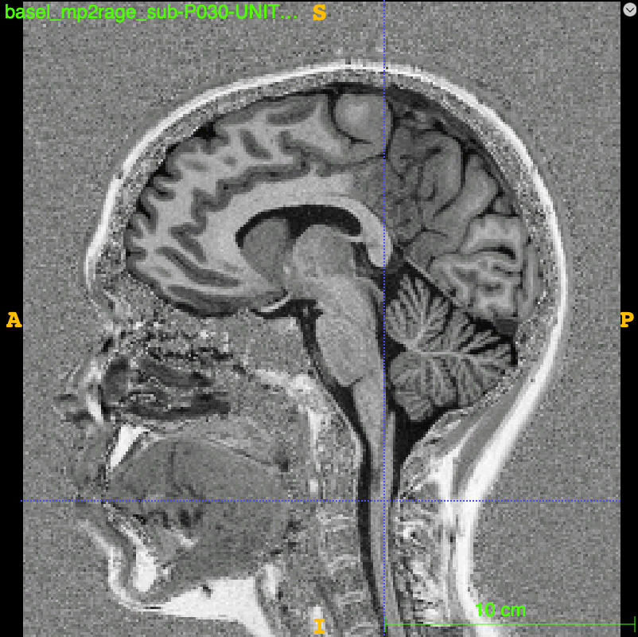
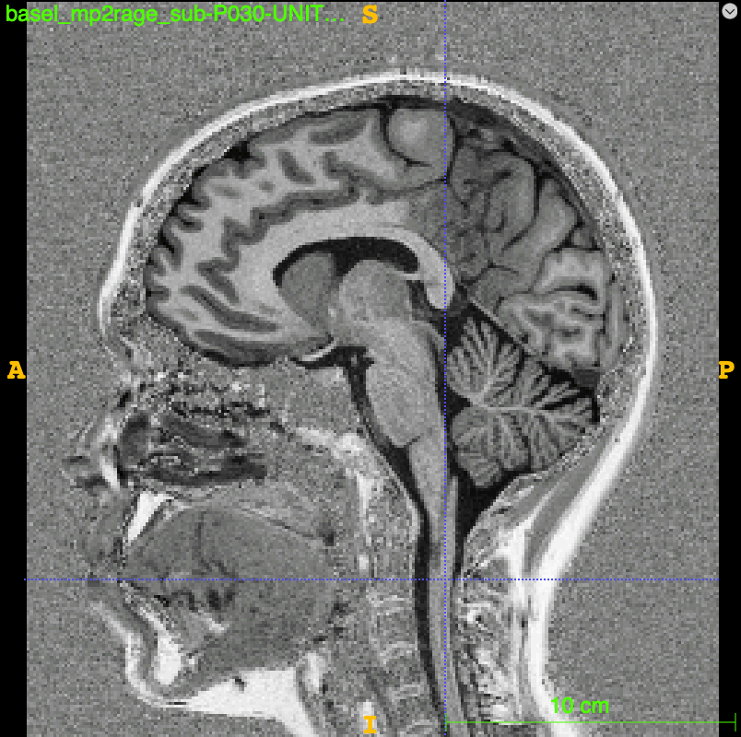
Visual results on Basel-MP2RAGE (another subject)
Manual segmentations
Aggregated-dataset model
Colorado-trained model
More results in the notebook!

Slide 10
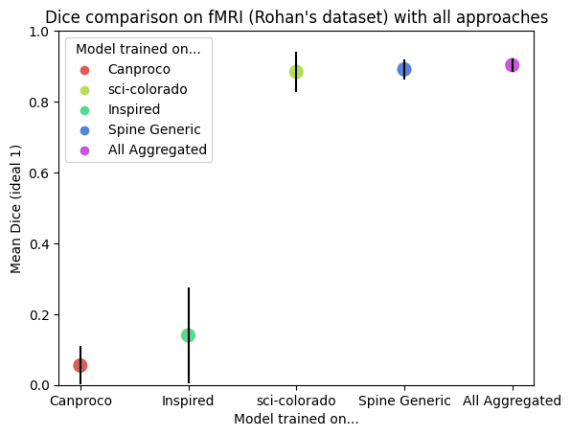
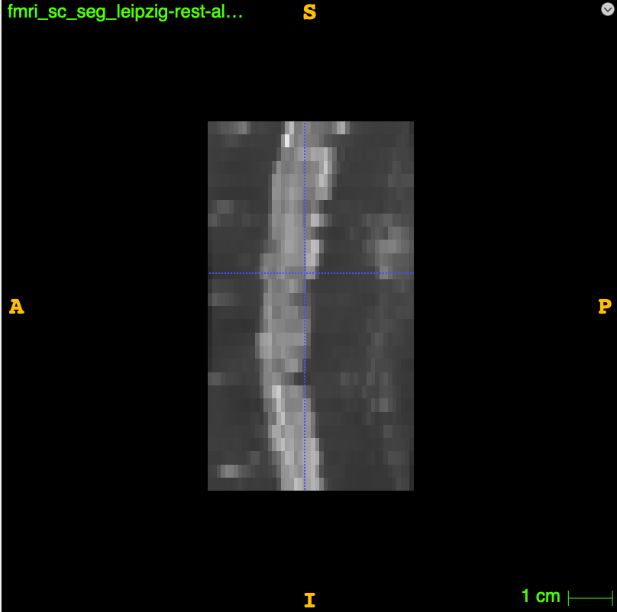
Results on Rohan’s EPI-GRE fMRI dataset
EPI-GRE contrast
(over all test subjects)

Slide 11
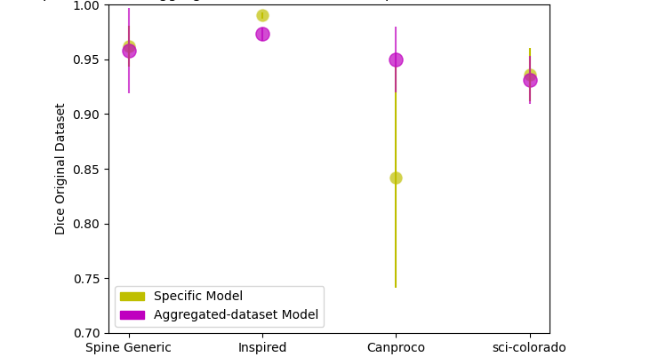
Comparing the aggregated-dataset model against specific models on their respective test sets
(over all test subjects)
Dataset 1, model 1
vs. Aggregated Model
Dataset 2, model 2
vs. Aggregated Model
Dataset 3, model 3
vs. Aggregated Model
Dataset 4, model 4
vs. Aggregated Model

Slide 12
Limitations…
Smaller datasets vs. larger datasets.
Not much contrast diversity.
Time constraint of the project.
No cross-validation, minimal visual analysis of the results

Slide 13
Deliverables
A Github repository with codes and scripts to reproduce training and testing. 🚧
A jupyter notebook of the analysis codes and visualisations for comparing the results. ✅
Documentation. 🚧
Model checkpoints for the nnUnet models trained on all 4 datasets. ✅

Slide 14
Future steps
Do a more thorough qualitative analysis of the results.
Add Basel and fMRI data to the training set.
Perform cross-validation.
Compare with SOTA models (e.g. sct-deepseg-sc)

Slide 15
References
GitHub: https://github.com/brainhack-school2023/bouchard_project
Cohen-Adad, J., Alonso-Ortiz, E., Abramovic, M., Arneitz, C., Atcheson, N., Barlow, L., Barry, R.L., Barth, M., Battiston, M., Büchel, C., et al.: Open-access quantitative mri data of the spinal cord and reproducibility across participants, sites and manufacturers. Scientific data 8(1), 219 (2021)
Martin, A.R., De Leener, B., Cohen-Adad, J., Kalsi-Ryan, S., Cadotte, D.W., Wilson, J.R., Tetreault, L., Nouri, A., Crawley, A., Mikulis, D.J., et al.: Monitoring for myelopathic progression with multiparametric quantitative mri. PLoS One 13(4), e0195733 (2018)
Barkhof, F., Filippi, M., Miller, D.H., Scheltens, P., Campi, A., Polman, C.H., Comi, G., Ader, H.J., Losseff, N., Valk, J.: Comparison of mri criteria at first presentation to predict conversion to clinically definite multiple sclerosis. Brain: a journal of neurology 120(11), 2059–2069 (1997)

